Slide 1
Counter

Slide 2
Counter
Counters are well known to us as “Timers”.
Counter circuits are the best example for the flip flop applications.
Counters are designed by grouping of flip flops and applying a single clock signal to them.
In simple words, the counters are those, which have the group of storage elements like flip flops to hold the count.

Slide 3
Asynchronous Counter(Ripple Counter)
1. The clock pulses are applied only to the CLK input of flip-flop A. Thus, flipflop A will toggle (change to its opposite state) each time the clock pulses make a negative (HIGH-to-LOW) transition. Note that JK1 for all FFs.
2. The normal output of flip-flop A acts as the CLK input for flip-flop B, and so flip-flop B will toggle each time the A output goes from 1 to 0. Similarly, flip-flop C will toggle when B goes from 1 to 0, and flip-flop D will toggle when C goes from 1 to 0.

Slide 4
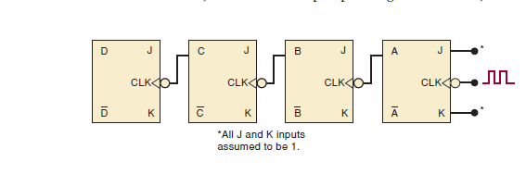
Figure: ripple counter

Slide 5
3. FF outputs D, C, B, and A represent a four-bit binary number, with D as the MSB. Let’s assume that all FFs have been cleared to the 0 state (CLEAR inputs are not shown). The waveforms in Figure 7-1 show that a binary counting sequence from 0000 to 1111 is followed as clock pulses are continuously applied.
4. After the NGT of the fifteenth clock pulse has occurred, the counter FFs are in the 1111 condition. On the sixteenth NGT, flip-flop A goes from 1 to 0, which causes flip-flop B to go from 1 to 0, and so on, until the counter is in the 0000 state. In other words, the counter has gone through one complete cycle (0000 through 1111) and has recycled back to 0000. From this point, it will begin a new counting cycle as subsequent clock pulses are applied.

Slide 6
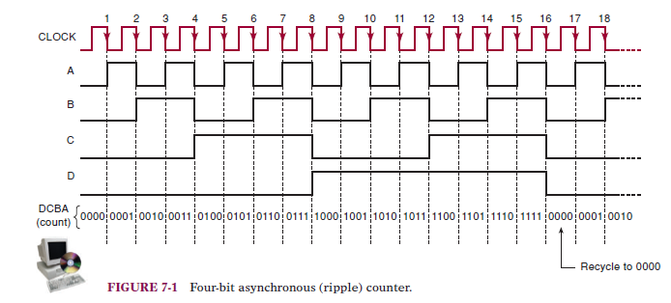

Slide 7
The counter in Figure 7-1 starts off in the 0000 state, and then clock pulses are applied. Some time later the clock pulses are removed, and the counter FFs read 0011. How many clock pulses have occurred?
The apparent answer seems to be 3 because 0011 is the binary equivalent of 3.With the information given, however there is no way to tell whether or not the counter has recycled. This means that there could have been 19 clock pulses; the first 16 pulses bring the counter back to 0000, and the last 3 bring it to 0011. There could have been 35 pulses (two complete cycles and then three more), or 51 pulses, and so on.

Slide 8
MOD Number
The counter in Figure 7-1 has 16 distinctly different states (0000 through 1111). Thus, it is a MOD-16 ripple counter. Recall that the MOD number is generally equal to the number of states that the counter goes through in each complete cycle before it recycles back to its starting state. The MOD number can be increased simply by adding more FFs to the counter. That is,
MOD number 2^{N}
where N is the number of FFs connected in the arrangement of Figure 7-1.

Slide 9
Frequency Division
In any counter, the signal at the output of the last FF (i.e., the
MSB) will have a frequency equal to the input clock frequency
divided by the MOD number of the counter.
For example, in a MOD-16 counter, the output from the last FF will have a frequency of 1/16 of the input clock frequency. Thus, it can also be called a divide-by-16 counter. Likewise, a MOD-8 counter has an output frequency of the input frequency; it is a divide-by-8 counter.

Slide 10
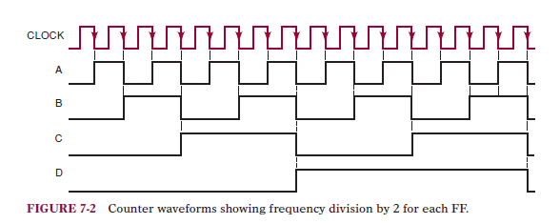

Slide 11
SYNCHRONOUS (PARALLEL) COUNTERS
Difference between synchronous and asynchronous:
The CLK inputs of all of the FFs are connected together so that the input
clock signal is applied to each FF simultaneously.
■ Only flip-flop A, the LSB, has its J and K inputs permanently at the HIGH
level.The J, K inputs of the other FFs are driven by some combination of
FF outputs.
■ The synchronous counter requires more circuitry than does the asynchronous counter.

Slide 12
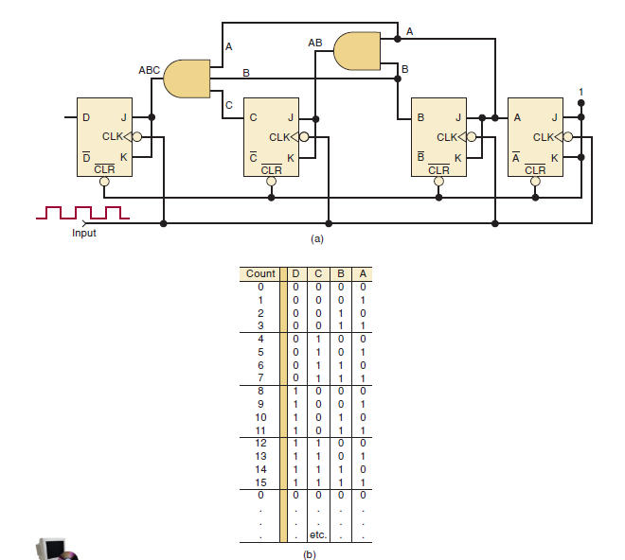
Figure: Synchronous mod 16 counter

Slide 13
Circuit Operation
For this circuit to count properly, on a given NGT of the clock, only those FFs that are supposed to toggle on that NGT should have J K 1 when that NGT occurs. Let’s look at the counting sequence in Figure 7-5(b) to see what this means for each FF. The counting sequence shows that the A flip-flop must change states at each NGT. For this reason, its J and K inputs are permanently HIGH so that it will toggle on each NGT of the clock input.

Slide 14
The counting sequence shows that flip-flop B must change states on each
NGT that occurs while A 1. For example, when the count is 0001, the next
NGT must toggle B to the 1 state; when the count is 0011, the next NGT must
toggle B to the 0 state; and so on. This operation is accomplished by connecting
output A to the J and K inputs of flip-flop B so that J K 1 only when A 1.
The counting sequence shows that flip-flop C must change states on each
NGT that occurs while A B 1. For example, when the count is 0011, the
next NGT must toggle C to the 1 state; when the count is 0111, the next NGT
must toggle C to the 0 state; and so on. By connecting the logic signal AB to
FF C’s J and K inputs, this FF will toggle only when A B 1.

Slide 15
In a like manner, we can see that flip-flop D must toggle on each NGT that
occurs while A B C 1.When the count is 0111, the next NGT must toggle
D to the 1 state; when the count is 1111, the next NGT must toggle D to the 0 state. By connecting the logic signal ABC to FF D’s J and K inputs, this FF will toggle only when A B C 1.
The basic principle for constructing a synchronous counter can therefore
be stated as follows:
Each FF should have its J and K inputs connected so that they are
HIGH only when the outputs of all lower-order FFs are in the HIGH
state.

Slide 16
COUNTERS WITH MOD NUMBERS < 2^{N}
The basic synchronous counter of Figure 7-5 is limited to MOD numbers that are equal to 2N, where N is the number of FFs. This value is actually the maximum MOD number that can be obtained using N flip-flops. The basic counter can be modified to produce MOD numbers less than 2N by allowing the counter to skip states that are normally part of the counting sequence.

Slide 17
Circuit Operations
1. The NAND output is connected to the asynchronous CLEAR inputs of each FF. As long as the NAND output is HIGH, it will have no effect on the counter. When it goes LOW, however, it will clear all of the FFs so that the counter immediately goes to the 000 state.
2. The inputs to the NAND gate are the outputs of the B and C flip-flops,
and so the NAND output will go LOW whenever B C 1.This condition
will occur when the counter goes from the 101 state to the 110 state on
the NGT of input pulse 6.The LOW at the NAND output will immediately
(generally within a few nanoseconds) clear the counter to the 000 state.
Once the FFs have been cleared, the NAND output goes back HIGH because
the B C 1 condition no longer exists.

Slide 18
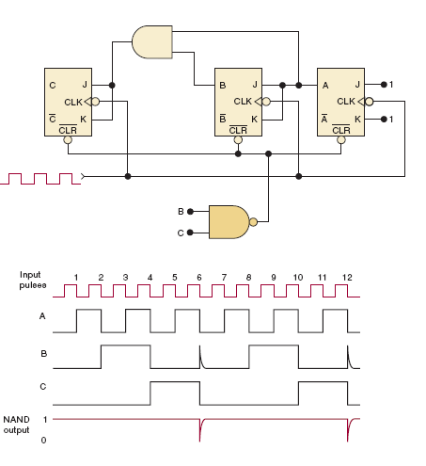

Slide 19
3. The counting sequence is, therefore, Although the counter does go to the 110 state, it remains there for only a few nanoseconds before it recycles to 000.Thus,we can essentially say that this counter counts from 000 (zero) to 101 (five) and then recycles to 000. It essentially skips 110 and 111 so that it goes through only six different states; thus, it is a MOD-6 counter.

Slide 20
State Transition Diagram
Figure 7-7(a) is the state transition diagram for the MOD-6 counter of Figure
7-6, showing how FFs C, B, and A change states as pulses are applied to the
CLK input of flip-flop A. Recall that each circle represents one of the possible
counter states and that the arrows indicate how one state changes to another
in response to an input clock pulse.
If we assume a starting count of 000, the diagram shows that the states of
the counter change normally up until the count of 101.When the next clock
pulse occurs, the counter temporarily goes to the 110 count before going to
the stable 000 count. The dotted lines indicate the temporary nature of the
110 state. As stated earlier, the duration of this temporary state is so short
that for most purposes we can consider that the counter goes directly from
101 to 000 (solid arrow).

Slide 21
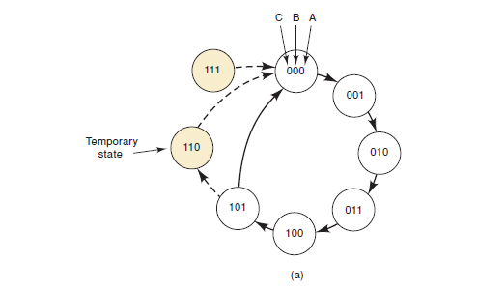

Slide 22
Note that there is no arrow into the 111 state because the counter can never advance to that state. However, the 111 state can occur on power-up when the FFs come up in random states. If that happens, the 111 condition will produce a LOW at the NAND gate output and immediately clear the counter to 000.Thus, the 111 state is also a temporary condition that ends up at 000.

Slide 23
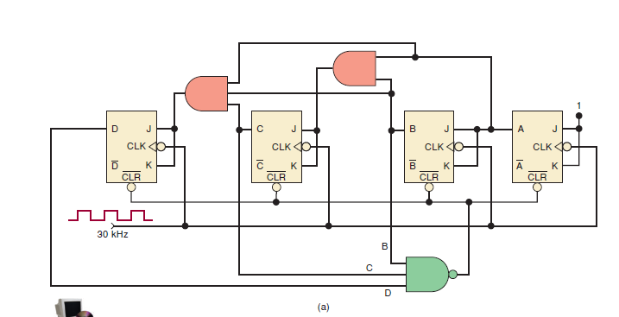
Mod-14 Counter

Slide 24
Decade/BCD Counter(Mod-10)
The MOD-10 counter of Example 7-7 is also referred to as a decade counter. In fact, a decade counter is any counter that has 10 distinct states, no matter what the sequence. A decade counter such as the one in Figure 7-8(b), which counts in sequence from 0000 (zero) through 1001 (decimal 9), is also commonly called a BCD counter because it uses only the 10 BCD code groups 0000, 0001, . . . ,1000, and 1001.
Any decade counter that counts in binary from 0000 to 1001 is a BCD counter.

Slide 25
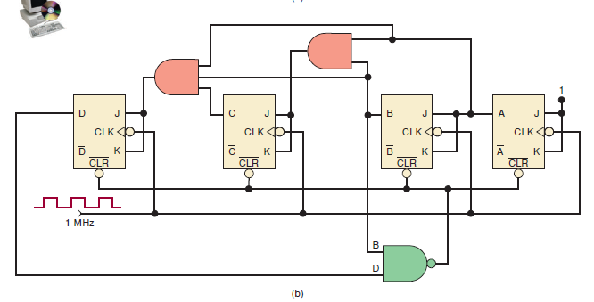
Mod-10 Counter

Slide 26
Problems Example 7.8
In Example 7-3, a MOD-60 counter was needed to divide the 60-Hz line frequency down to 1 Hz. Construct an appropriate MOD-60 counter.
Solutions:

Slide 27
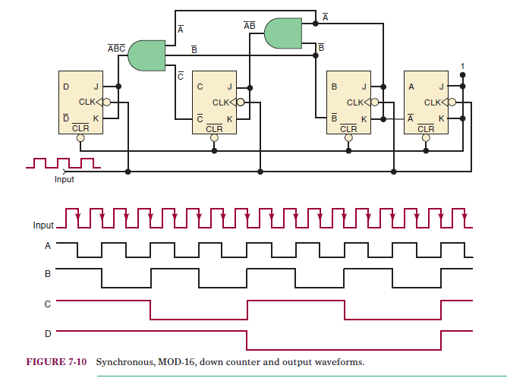
SYNCHRONOUS DOWN Counter

